Slide 1
User Testing and 1959 Diplomacy
Noah Solnick

Slide 2

Who am I?
Flickr - David Ohmer

Slide 3

Who are you?
You want to learn more about User Testing
You’re really interested in World History
None of the above
Notes:
Who is group a/b/c
Good news, bad news – good news first / bad news first?
Group a happy: Yes user testing,
Group B: unhappy: No talk about history
Sorry group B. but! Hoping there’s a group D who likes to play nerdy board games
– because we’re going to talk about nerdy boardgames

Slide 4

Why?
Notes:
Introduce Talk
Specifically, we’re going to talk about how the keys to winning in a boardgame called Diplomacy, are very similar to the keys to winning in User Testing
Why is this important? Because A. diplomacy is a ton of fun. And B. as almost all successful startups will tell you, it’s important to go fast, but it’s more important to go fast in the right direction.

Slide 5
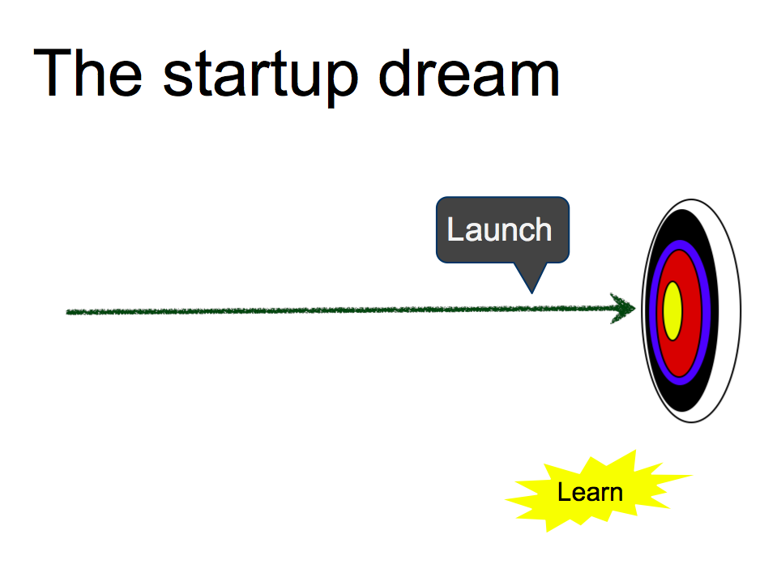
Why? (thanks Google)
Google Ventures: User Research, Quick and Dirty: http://www.youtube.com/watch?v=WpzmOH0hrEM
Notes:
Launch first – launch fast

Slide 6
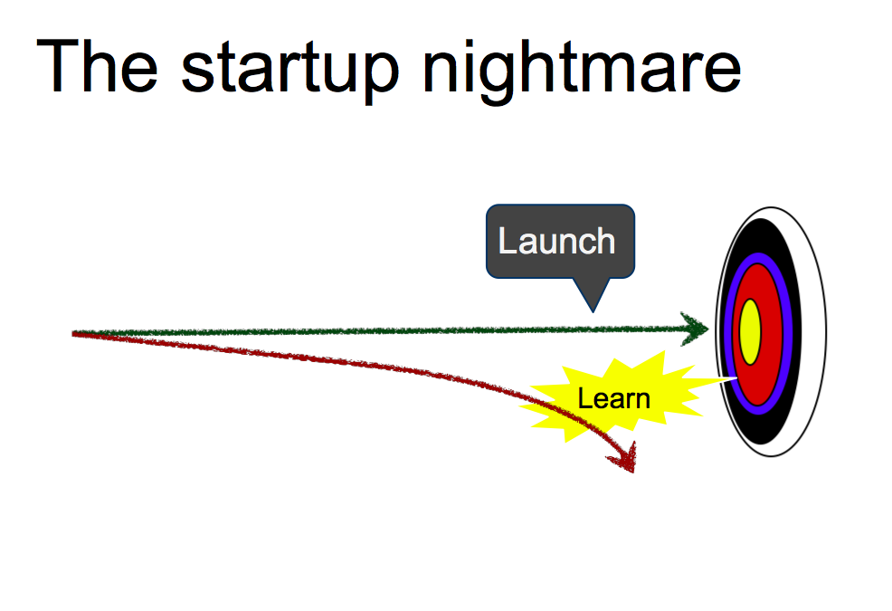
Notes:
Risk is

Slide 7
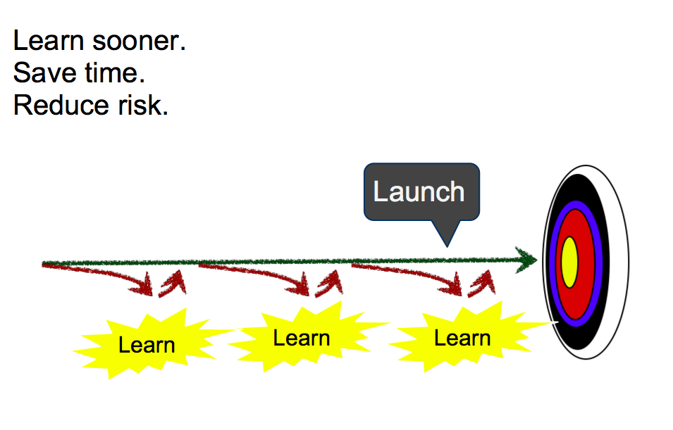
Notes:
Iterative process!

Slide 8
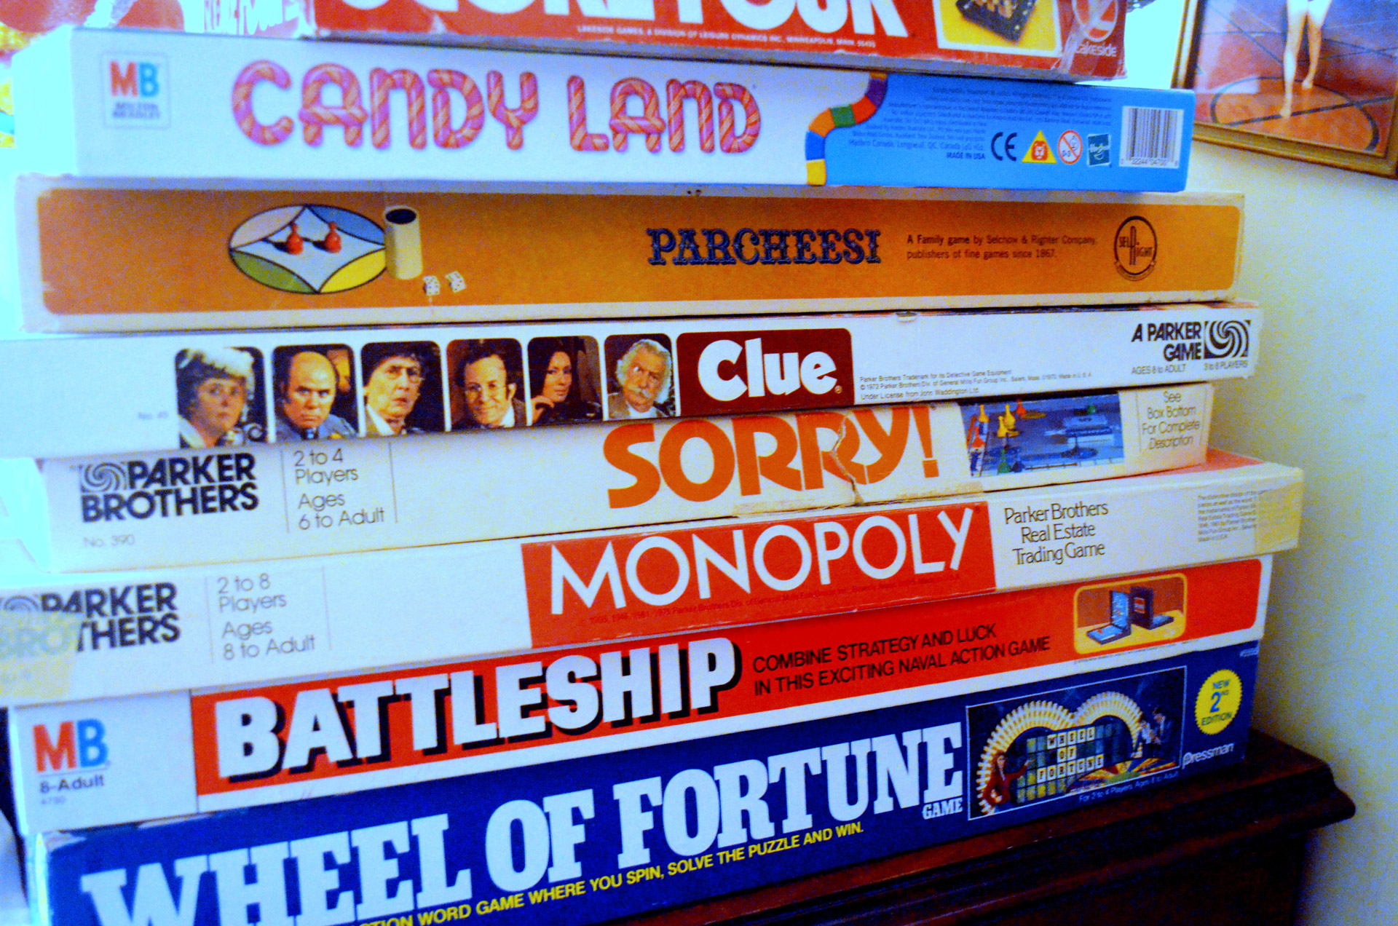

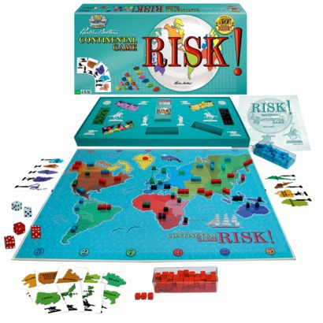
Notes:
Introduce Diplomacy
diplomacy - nerdy boardgame. Monopoly, hungry hungry hippos, or even settlers of catan
Diplomacy 1959 in USA
Game set right before the outbreak of World War I – purpose is to take over all the land on the board
If you’re saying wait a minute… Risk 1957 in France
Difference! In risk, roll dice, one person, steamroll – diplomacy, all units have the same strength…

Slide 9
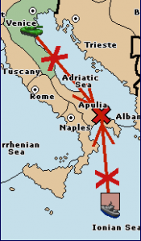

Figure A
Notes:
Cooperation – coordination!

Slide 10

How to win
Know who you’re playing with (Don’t play with friends)
Talk it out
Don’t give yourself away
Notes:
learn and understand the players so you can make good strategic decisions
Know who you’re playing with (Don’t play with friends)
Understand their personalities, their motivations – some are in it just for the fun, others are more serious. Boyfriend / girlfriend
Talk it out
Two ways to play diplomacy – face to face – over the internet – communication
Don’t give yourself away
IN the beginning, everything is roses and optimism. Unfortunately diplomacy is a 0 sum game. There are 34 supply centers, and there can be only one winner. That means there’s a delicate line between beautiful friendship, and a body at the bottom of the lake.

Slide 11
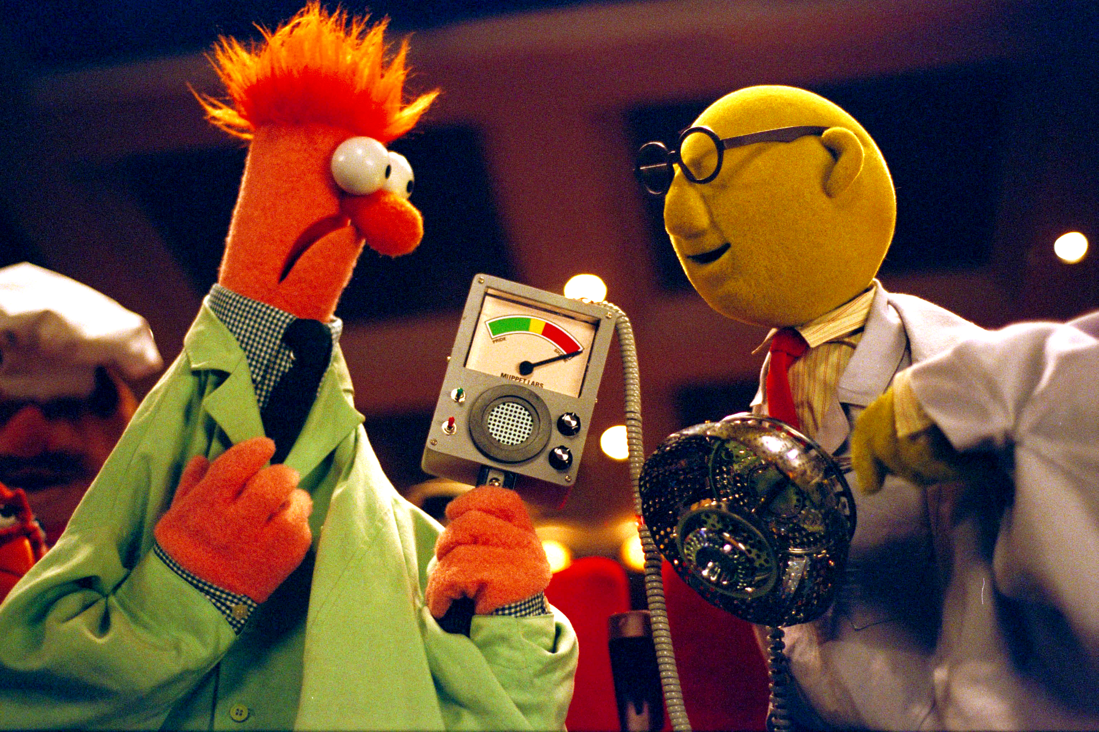
User Testing
Learn and understand the your customer so you can make good strategic decisions
Notes:
Many different types of user testing
Customer discovery – generally – What is the goal you’re trying to achieve? What problems do you have? How do you solve them now?
Usability testing – How does this tool work or not work in achieving that goal? Do you understand how to use the tool?
Applies to both

Slide 12

Know who you’re testing with
Notes:
Know who you’re testing with– who are your target users? What is your target segment? Target users may be huge (23-35 Males in Shanghai) Target segment should be smaller (23-35 Males in Shanghai who go to the gym at least 3 times a week) they have very different sets of problems
(Don’t test with friends)

Slide 13
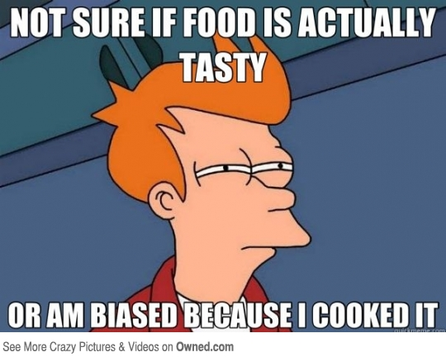
(Don’t test with friends)
Notes:
Testing with friends – easy but wrong!
Social Desirability : Users generally tell you what they think you want to hear and are less likely to say disparaging things about people (seen and unseen) and products. This often means users blaming themselves (not the product) if they have a problem but it can also impact preferences.

Slide 14

Talk it out
Notes:
Get out (or get them in!) - Steve Blank - Get out of the building – internal brainstorming only goes so far, and it’s easy and sometimes satisfying to argue for hours over the way things should be done or what users want
You (may not be your user) - Usually not in their shoes
Generally one on one is better – testing in groups leads to groupthink
Focus on actual past actions – not hypothetical questions
How often do you work out? VS How many times did you work out in the past week?

Slide 15

Don’t give yourself away
Notes:
Social Desirability – by knowing about your product, people will be inclined to tell you want you want to hear
You might be talking to users who work at your competitors or would otherwise have a reason to give you bad data
Don’t lead the subject in interviews
Would you rather use this version of the new one?
Instead – show and time them
Be as neutral as possible!

Slide 16
How to win
Know who you’re playing with (Don’t play with friends)
Talk it out
Don’t give yourself away
Notes:
learn and understand the players so you can make good strategic decisions

Slide 17
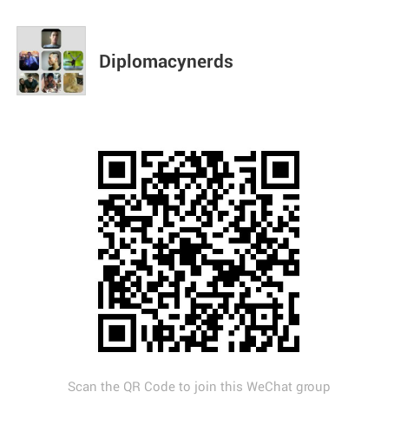
Thank You!
Try a game of Diplomacy?
Noah.Solnick@IndulgeSmart.com

